Slide 1
UNIT 12. DON’T RIDE YOUR BIKE TOO FAST!
LESSON 2

Slide 2
Cut yourself

Slide 3
Get a burn
Play with the stove

Slide 4
Ride your bike too fast
Fall off your bike

Slide 5
Break your arm
Break your leg

Slide 6
Run down the stairs

Slide 8
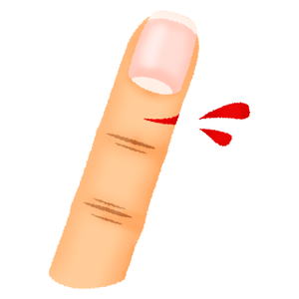
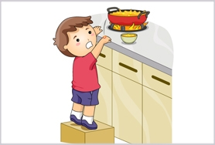
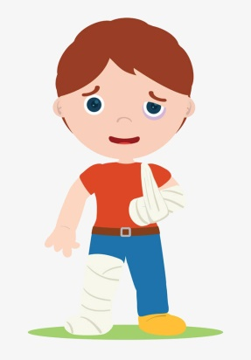
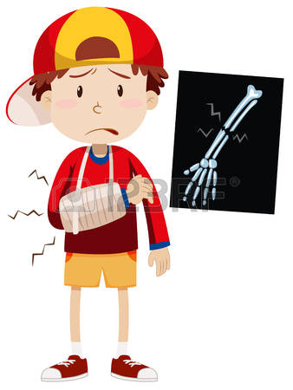
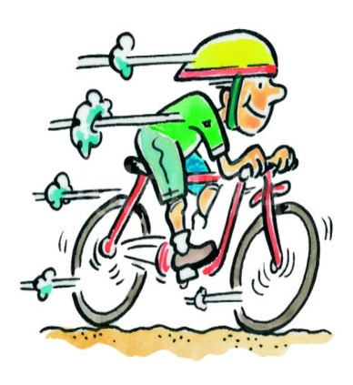
1. Vocabulary
- cut yourself
- get a burn
- fall off your bike
- break your arm
- break your leg
2. Model sentence
Why shouldn’t ride your bike too fast?
Because you may fall off your bike.

Slide 10
Why shouldn’t
play with the knife?
Because you may
cut yourself.

Slide 11
Why shouldn’t
play with the stove?
Because you may
get a burn.

Slide 12
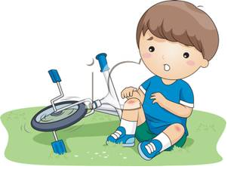
Why shouldn’t
ride your bike too fast?
Because you may
fall off your bike.

Slide 13
Why shouldn’t
run down the stairs?
Because you may
break your arm.

Slide 14
LISTEN AND COMPLETE
1. Tony shouldn’t play with the knife because it’s very .
sharp
2. Nam shouldn’t climb the because he may fall and break his leg.
wall
3. Mai shouldn’t play with the stove because she may get a .
burn
4. Tom shouldn’t ride too fast because he may fall off his bike and break his .
arm

Slide 15
READ AND COMPLETE
why
see
knife
don‘t
yourself
Tom: What are you holding in your hand?
Phong: A (1) .
Tom: Oh, no. It’s dangerous. (2) play with it!
Phong: (3) shouldn’t I play with it?
Tom: Because you may cut (4) .
Phong: I can (5) that. Thank you, Tom.
knife
Don‘t
Why
yourself
see

Slide 16
LET’S PLAY

